Slide 1
The Use Of Hydraulic Stage House at Tidal Flood Area
Case Study of Kemijen Semarang
B.Tyas Susanti¹, Etty E.Listiati¹, IM.Tri Hesti Mulyani¹, Widija Suseno²
^{1 Department of Architecture}
2Department of Civil Engineering
Soegijapranata Catholic University, Semarang, Indonesia

Slide 2
BACKGROUND
Tidal flood is one of the problems found in Semarang, and Kemijen is one of the areas in Semarang which is an area affected by tide.
Rising Sea level and land subsidence contributed to the problem of tidal flood. It is reported that the area close to Kemijen has land subsidence around 13.5 cm / year.
Some measures performed well by the community had succeeded in reducing the impact of tide, such as, by removing the water that inundates the area using pumps
Other solution that has been made by the community in Kemijen area to survive against flooding and tide is by elevating their homes

Slide 3
Problem of elevating the house
Substantial costs required
House elevation need to be carried out for almost every 5 years.
To overcome this problem, an innovation has been carried out by making a hydraulic stage house, and this design has been build in RW 4, Kemijen

Slide 4
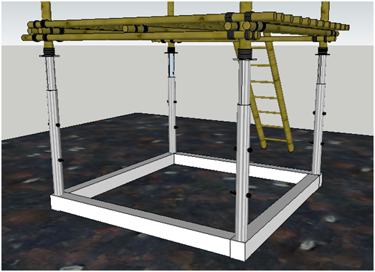
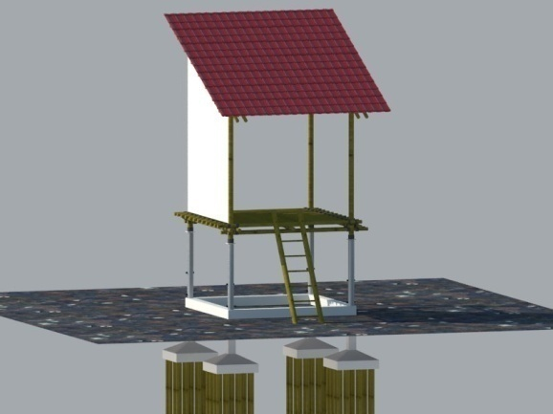
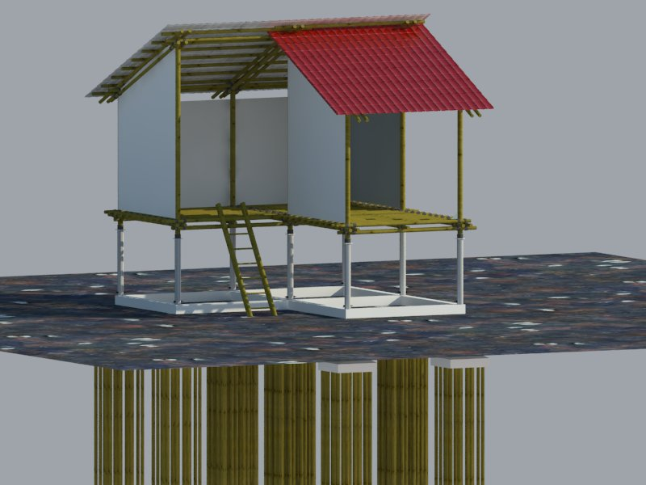
Desain adaptif hydrolic bamboo house
The Adapative House model is in the form of a hydraulic stage built 1.5 meters above the road (house on stilts) can be used to overcome flooding or tidal flooding for 5-10 years. If the water has reached the surface of the house, the floor of the house can be raised. Once raised as high as 50 cm, it is sufficient for 3-5 years

Slide 5
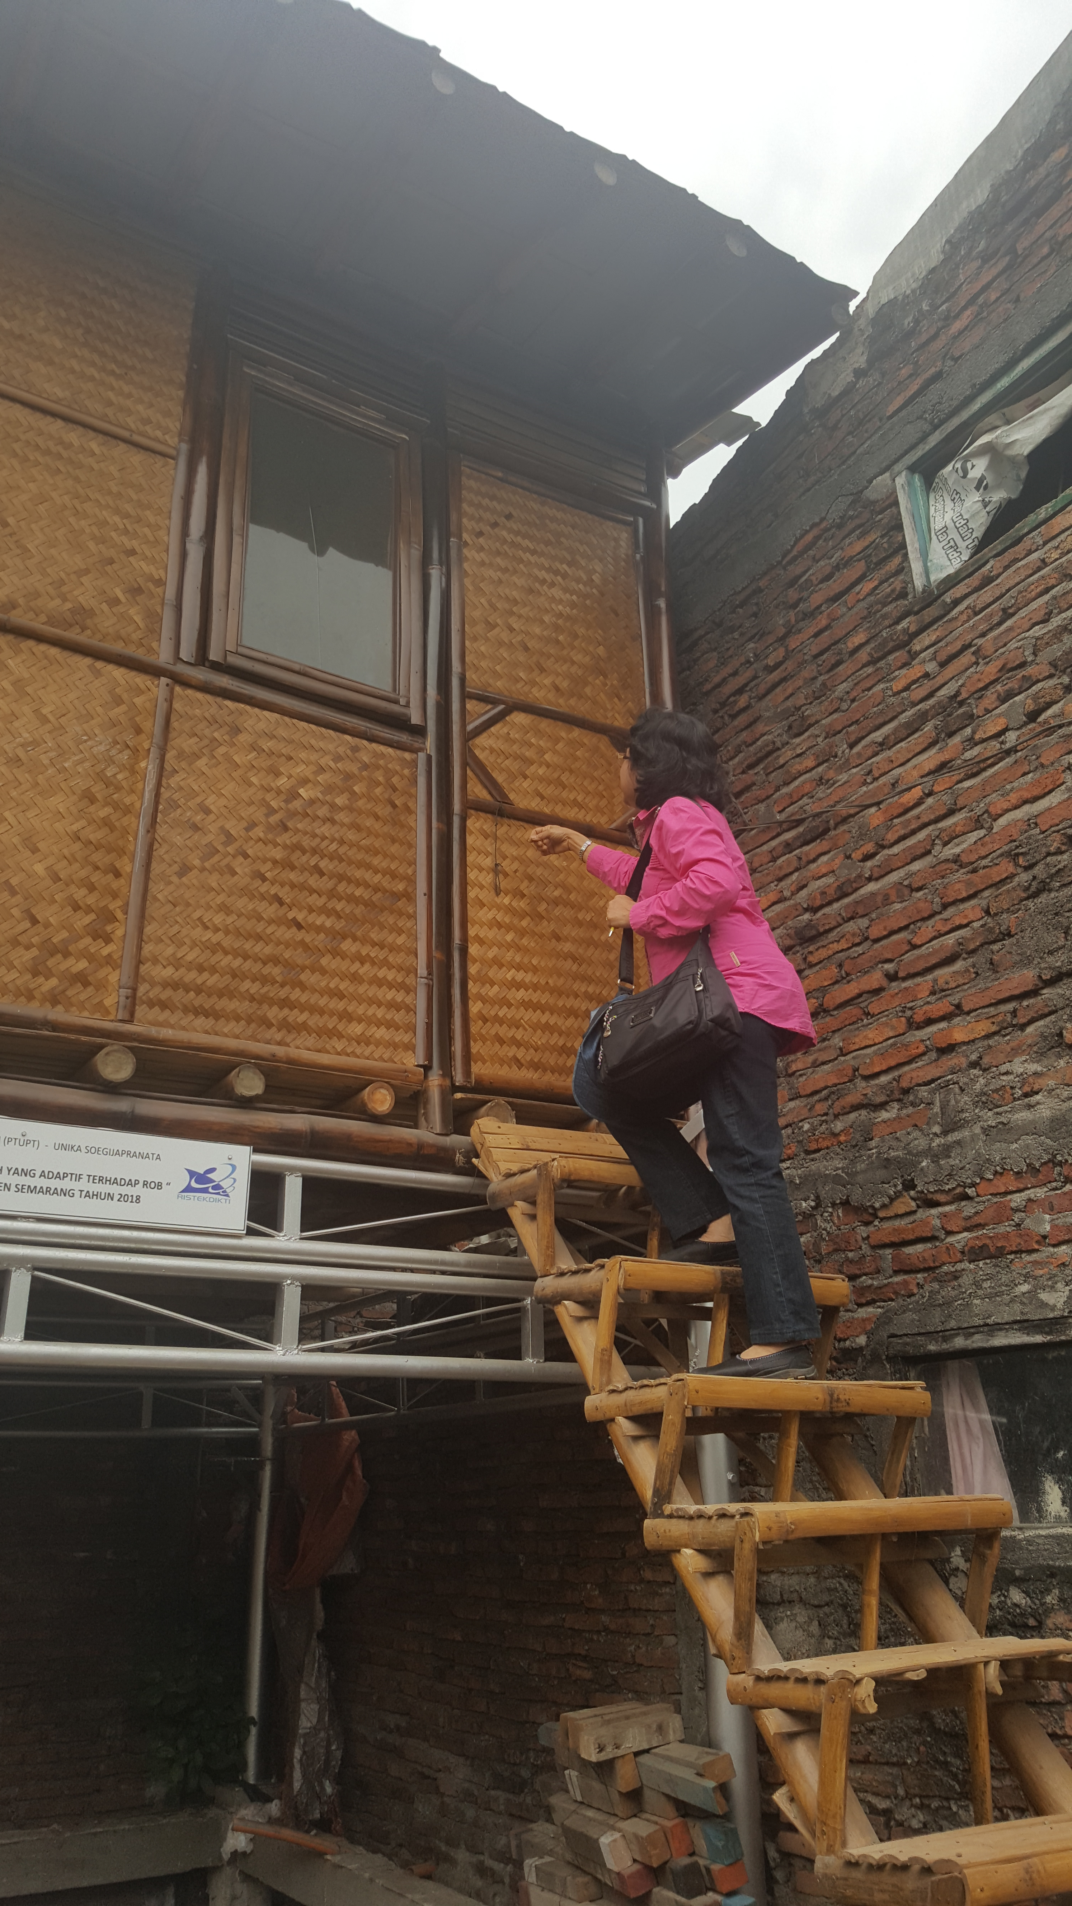
Adaptive bamboo hydraulic house
Hydraulic stage house is a stilt house with a floor height that can be adjusted manually. The height of the stage house that has been made is 1.5 meters above the road level. The figure of 1.5 meter is obtained from water level data at the time of tide and flooding which ranges from 30 cm to 1 meter

Slide 6
Methodology
After one stage house had been built at the location of one of the residents of RW IV who was still affected by the tide, an evaluation was carried out on whether the house could be utilized by the owner.
The evaluation phase was carried out by conducting approaches, such as conducting interviews with residents and their family members to see how they used the building.
The interviews were conducted in depth to explore all issues and the future expectations related to the use of the buildings.
In addition to the interviews with the owners or residents, Focus Group Discussions were also held

Slide 7
Methodology
In addition to the interviews with the owners or residents, Focus Group Discussions were also held
The purpose of the FGD was to get inputs on the uses of the stage houses after they are inhabited and to ask for all shortcomings that still need to be corrected in the future.
Some of the expectations of the residents and the community regarding the stage houses will also complement the perfection of the hydraulic stage houses.

Slide 8
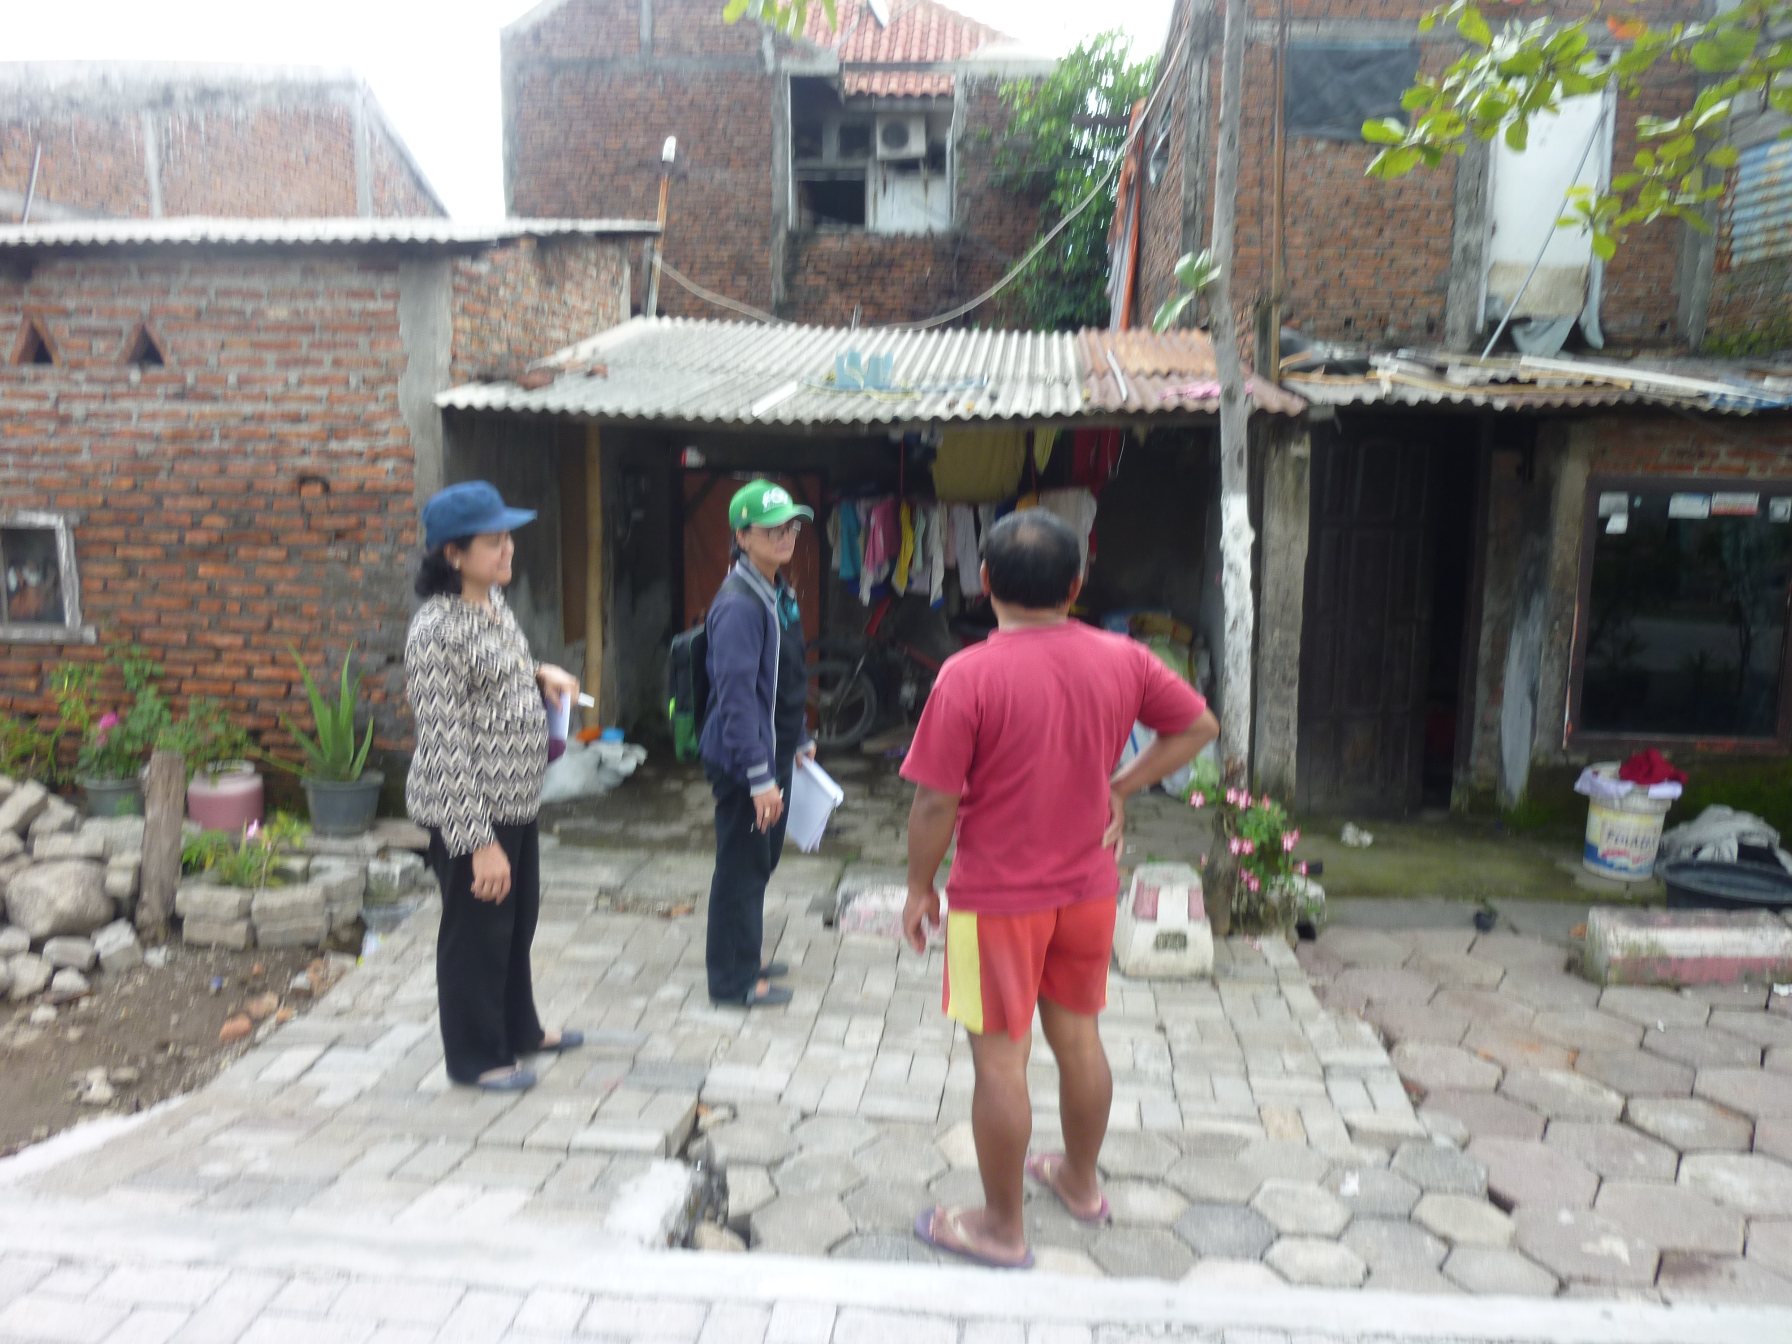
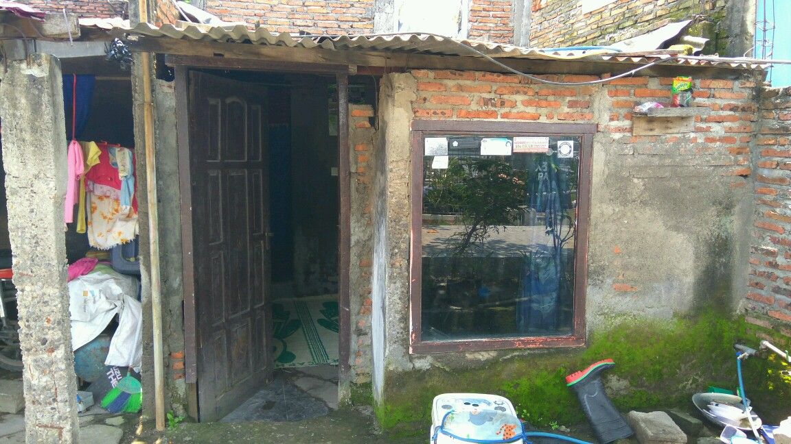
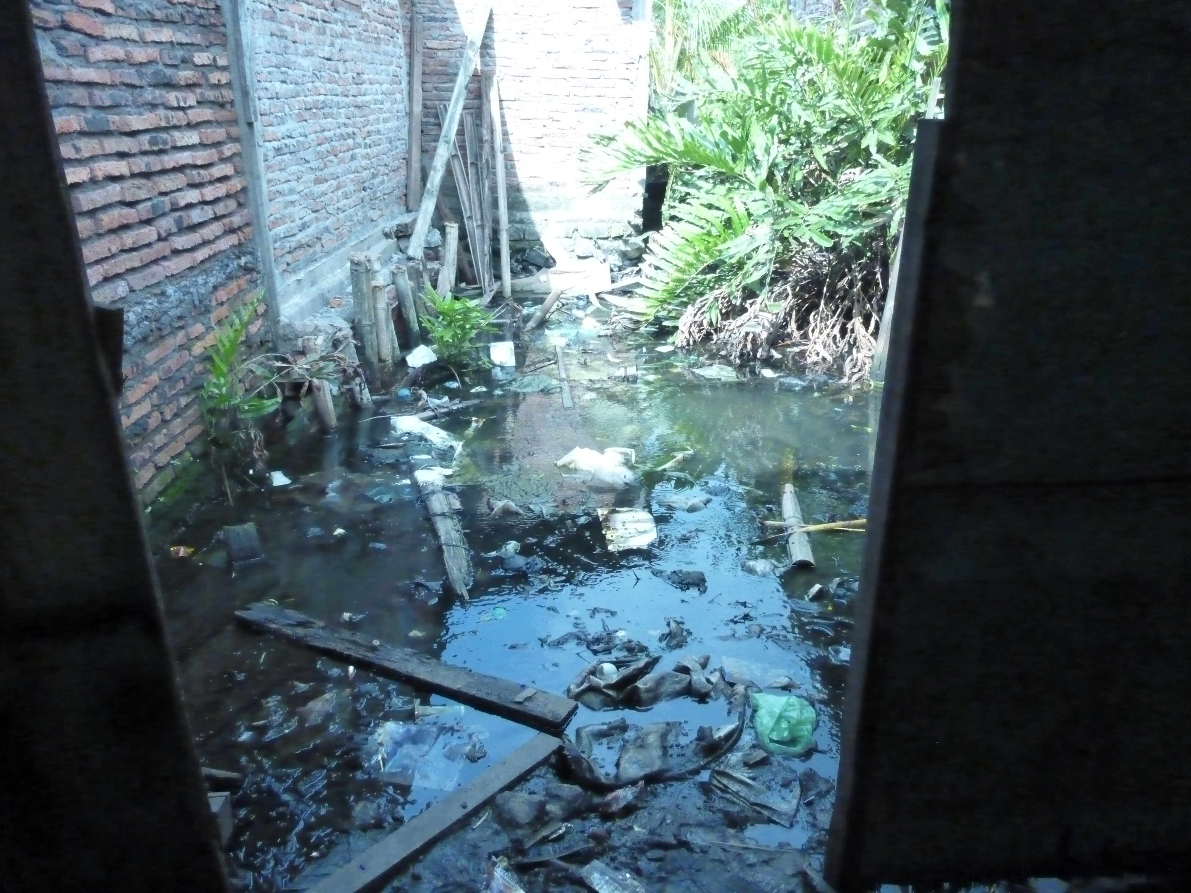
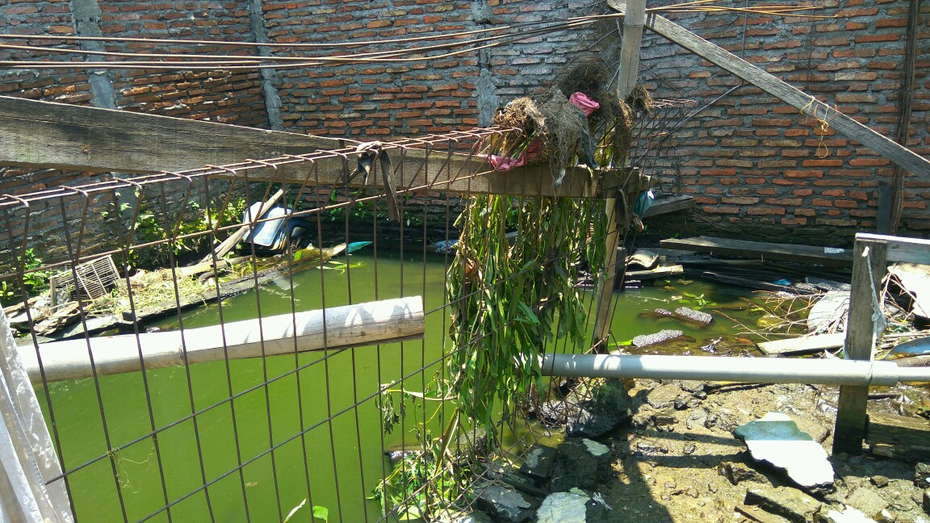
Location

Slide 9
Results and Discussions
A hydraulic stage house had been built in the yard of Mr. Heri's house in 2018. The house was built in the side yard of the main house that was not utilized. The yard was originally the home of his parents which was finally "drowned" because of land subsidence in the area.
The stage house (figure 3) was built with a height of 1.5 meters to avoid being flooded. At present, Mr. Heri's family has used the house, especially when it rains by utilizing the existing space of 3 x 3 square meters.

Slide 10
Results and Discussions
By utilizing the upper bedroom, there is no more concern for Mr. Heri's family with the water that will enter and disturb their sleep.
The function of the 3 x 3 square meter space on this stage house was not only used as a bedroom where Mr. Heri's family took refuge when it rains, but it is also used as a living room when the friends of Mr. Heri’s family visit them. The space can accommodate around 10 people and has been used for the neighborhood meeting.

Slide 11
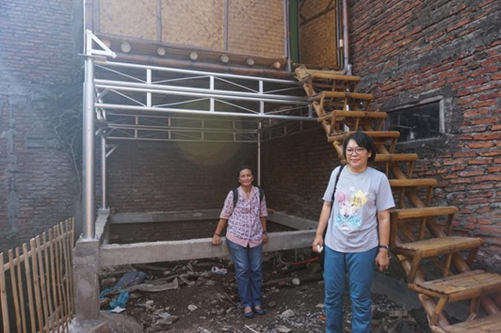
Results and Discussions
In addition, the space upstair has been fully utilized, while the lower space is still not fully utilized. The lower part is still a pit/ empty space with a tie beam (sloof) that functions as a reinforcement beam
The pit/basement has a height of 1.5 meters, and currently its use is only used for drying clothes. There is no floor covering so that it cannot be used to accommodate family activities

Slide 12
Results and Discussions
Some adjustmens
the lower area / pit can be used for other activities with a little adjustment. From the results of the interviews with the homeowners, there were a number of ideas stated:
1. Becoming a living room:
2. Utilization for Economic Activities

Slide 13
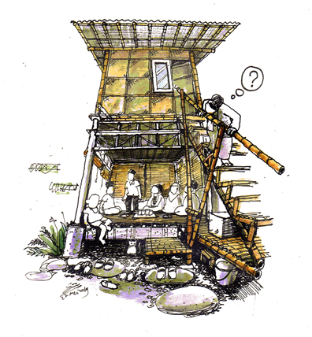
Adjustmen for living room
“Lesehan Model”, This is also to minimize the furnitures placed in the room given the limited strength of the support beam.
With the use of the lower space as a living room or public space, the upper room can be fully used as a sleeping area so that it does not interfere with the activity of Mr. Heri's family members.

Slide 14
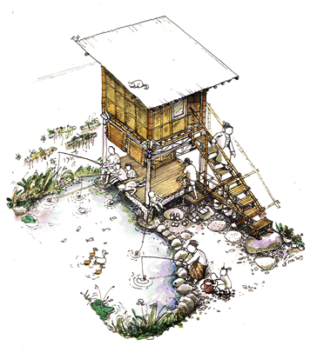
Utilization for Economic Activities
Reason:
Beside the stage house built, there is still a bare land in the form of a pond. At present, the land has not been used. It is still flooded with water and the surrounding land turns into slum because the pool is also a waste dump, especially for the children of the homeowners. This condition does not only cause slums, but it is also a cause of dengue fever due to many mosquito larvae in the pond

Slide 15
The burden allowed on the stage house and the pit as follows:
1. The remaining bearing capacity of the foundation is 8000 - 4600 = 3400 kg, and it can be used for bamboo load and mats for basement bases of approximately 20 bamboo sticks @ 12 kg = 240 kg
2. The human life burden is 20 people (10 people in the upper room and 10 people in the lower room), each of whom is considered to weigh 100 kg / person
3. Then, the rest, 3400 - 240 - 2000 = 1160 kg, can be used for infrastructure facilities on the upstairs such as wardrobe (+/- 50 kg), spring bed (+/- 25 kg), TV 20 "(+/- 15 kg), fan (+/- 10 kg),
4. The rest of 1160 - 100 = 1060 kg can be used for fishing facilities downstairs

Slide 16
Conclusion
The hydraulic stage house built in the yard of one of the residents of RW IV had been used well.
The upper room has now been utilized to the maximum for the bedroom and also the reception room. However, this utilization has not been maximized because there is still empty space on the lower floor that is still unused.
There are two uses that can be used, such as the use as a living room so that the upper room can

Slide 17
THANK YOU

