Slide 1
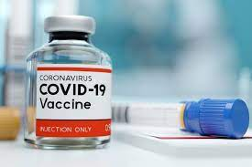
Covid 19 Vaccination Rights for Indonesian Children
Bernadeta Resti Nurhayati

Slide 2
H’i im Indonesian children

Slide 3
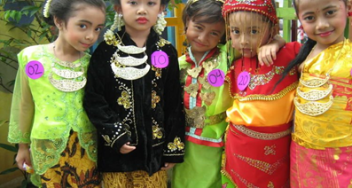
Preliminary
Children are the heir of the nation's future.
They need to be protected to achieve proper maturity
Therefore, the Indonesian government are obliged to provide convincing regulations to provide such protection.
Children's rights are also considered as human rights. Government do regulate it specifically through second Amendment to the 1945 Constitution, in particular:

Slide 4
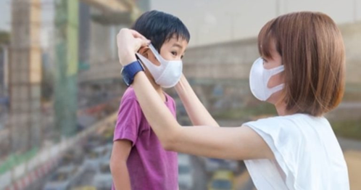
Article 28 B paragraph (2): "Every child has the rights to survive, grow and develop and has the rights to protection from violence and discrimination".
Article 28 H paragraph (1): "Everyone has the rights to live in physical and spiritual prosperity, to have a place to live, and to have a good and healthy living environment and have the rights to obtain health services".

Slide 5
Problem
How does this play part to vaccinations for children?
If the rights to health becomes the part of children rights, in the middle of this pandemic, when they get the vaccines?

Slide 6
Analysis
What does Convention of the Rights of The Child (CRC) state about Children rights to health?
Article 24
1. States Parties recognize the right of the child to the enjoyment of the highest attainable standard of health and to facilities for the treatment of illness and rehabilitation of health. States Parties shall strive to ensure that no child is deprived of his or her right of access to such health care services.
2. States Parties shall pursue full implementation of this right and, in particular, shall take appropriate measures:
(a) To diminish infant and child mortality;
(b) To ensure the provision of necessary medical assistance and health care to all children with emphasis on the development of primary health care;
(c) To combat disease and malnutrition, including within the framework of primary health care, through, inter alia, the application of readily available technology and through the provision of adequate nutritious foods and clean drinking-water, taking into consideration the dangers and risks of environmental pollution;

Slide 7
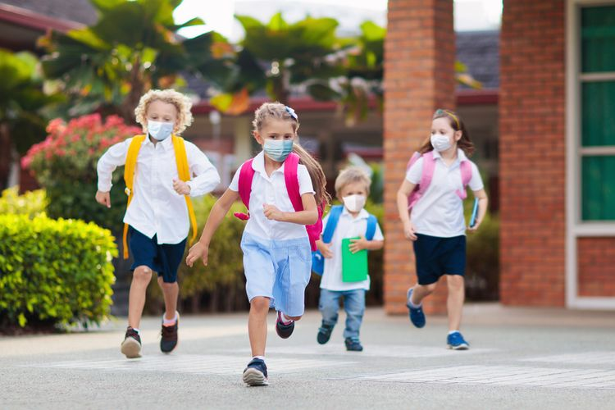
How does Act of Children Protection Regulate their rights to health?
Art 8: “Every children are entitled to proper medical services, social assurance that ensures sufficient their physical, mental, spiritual, and social needs.”
Art 44:
(1) Government are obliged to provide health facilities and organize comprehensive medical amenities for the children to reach equal and proper health even since pregnancy period.
(2) The health facilites and comprehensive medical amenities as in the paragraph (1) are publicly supported

Slide 8
Regulation of children wellbeingness according to the Act of Health Law
Art 131
All attempts to ensure infant and children health must be addressed to prepare healthy, intelligent, quality in the generations to come as well to supress the figure of infant and children death.
All that attempts are organized to aim their wellbeingness since pregnancy period, upon after their birth, up until they reach 18 years old

Slide 9
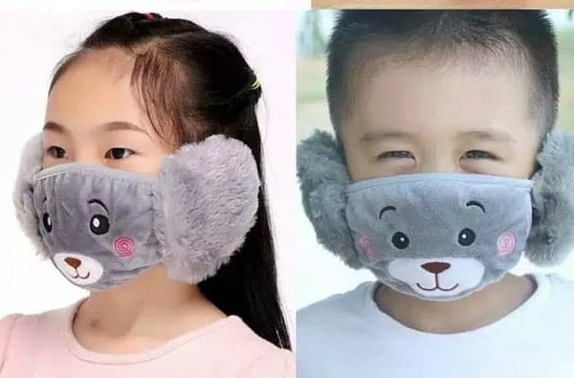
The health report accounts that:
Based on available data, most children and adolescents infected with the Covid-19 virus have only mild symptoms or even no symptoms at all.
However, there are some conditions in children that make them vulnerable to serious complications.
Asthma, obesity, heart disease, another comorbid
Neurological conditions, child development.

Slide 10
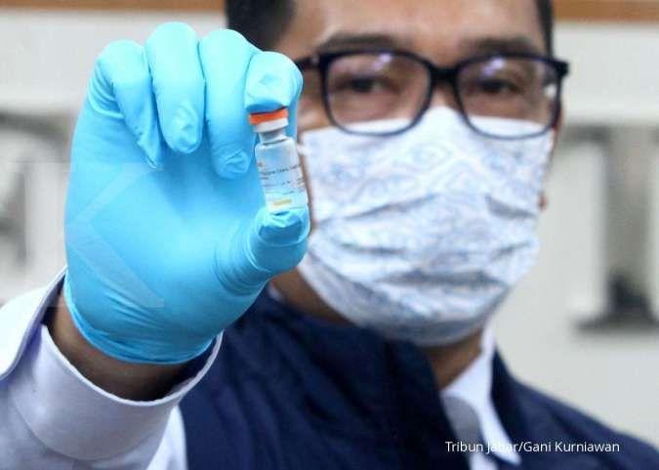
Doctor Jose Romero from Centers for Disease Control and Prevention/CDC express his hope to see immediate vaccines trial on children before Q2 of 2021
Should they are proved to be effective and safe, all children below 18 years old shall be receiving vaccines shot before 2021 ends

Slide 11
There are preliminary step of vaccines shot trial on adults to ensure how they might affect overall population health as well as its effectiveness and soundness
There are several candidates of children-addressing vaccines but to date no one is ready even for urgent measure
We should empower and encourage bigger and more purposeful covid 19 pandemic handling to achieve better children protection

Slide 12
Conclusion
Infant and Children are also priority to the rights to heatlh, including vaccines shot that are instrumental to overall population protection during this pandemic
Children-specified vaccines are currently undergoing further medical testing so we are longing for them to get ready as soon as possible
Should they are ready immediately, the government shall organize convenient vaccines shot services to get them protected

Slide 13
