Slide 1
OUTLOOK EKONOMI 2015
Angelina Ika Rahutami
Universitas Katolik Soegijapranata
13 JANUARI 2015
FORUM BISNIS TALK SHOW RADIO

Slide 2
US economic outlook
We have increased our 2015 forecast for US GDP growth to 3.3%, from 3.2%, reflecting the positive impact of lower energy prices on consumer spending.
2014 has seen the strongest job growth for 15 years and real wages are finally picking up. Strong private consumption will offset the drag from sluggish external demand.
We expect the Fed to start raising policy rates in mid-2015.
Domestic energy production is contributing to a narrowing of the trade deficit although the recent surge in the dollar will erode US competitiveness.
US
Western
Europe
Japan
Emerging markets
Oil
Non-oil commodities
Monetary policy
Currency
Forecast risks
Forecast risks (cont.)
Summary
Notes:
The euro zone is forecast to underperform the US in 2009 as it suffers from a massive drop in external demand, the impact of the global financial crisis and the unwinding of domestic imbalances. The US recovery will be driven partly by aggressive fiscal stimulus which will make itself felt from the second half of 2009 and some restocking, after the extensive drawdown of inventories in the first half 2009.

Slide 3
Western Europe economic outlook
In the euro zone, lower oil prices will provide a modest lift to consumption, but the European Central Bank is worried that this could push inflation expectations down further, increasing the risk of a debt deflation cycle.
Conditions remain weak in the major economies, including Germany, which has been hurt by the sanctions on Russia. Spain and are faring better.
The French and Italian governments are trying to pass structural reforms.
The results of EU-wide bank stress tests were credible and positive. Some Italian and Greek banks need to raise more capital.
US
Western
Europe
Japan
Emerging markets
Oil
Non-oil commodities
Monetary policy
Currency
Forecast risks
Forecast risks (cont.)
Summary
Notes:
The euro zone is forecast to underperform the US in 2009, largely reflecting the severe weakness of Germany, which, like Japan, remains highly exposed to the global trade cycle. The US recovery will be driven partly by aggressive fiscal stimulus, which will make itself felt from the second half of 2009.

Slide 4
Japan economic outlook
Japan fell into recession in the third quarter as GDP contracted again. After a strong first quarter, the economy has slumped badly following an April tax rise.
Japan's slide back into recession is undermining confidence in Shinzo Abe's economic programme. He called a snap election for December in the hope that a fresh mandate will enable him to push through contentious structural reforms.
We maintain our forecast that expansive policy will keep the economy on a growth path in the medium term.
Real interest rates have become negative for the first time in years but real wages remain depressed.
US
Western
Europe
Japan
Emerging markets
Oil
Non-oil commodities
Monetary policy
Currency
Forecast risks
Forecast risks (cont.)
Summary

Slide 5
Emerging market economic outlook
Emerging markets face a testing 2015 as the Fed tightens monetary policy.
We have raised our 2015 GDP growth forecast for China to 7.1% on the back of the decline in oil prices. India and South Korea will also benefit.
Russia, already hit by Western sanctions, will be one of the big losers from lower oil prices. All countries heavily dependent on oil for fiscal or export revenue will have to tighten their belts.
Among the oil exporters, Venezuela is most exposed to payment problems, having failed to save sufficiently when prices were high.
US
Western
Europe
Japan
Emerging markets
Oil
Non-oil commodities
Monetary policy
Currency
Forecast risks
Forecast risks (cont.)
Summary

Slide 6
Oil price and demand outlook
Oil prices have continued to fall as new supply from the US has swamped only meagre demand from major consumers.
At a meeting in November OPEC failed to reach consensus on cutting its production target, resulting in further falls in the price.
Several US energy firms have announced cuts to investment spending in 2015 as margins are squeezed.
The price of dated Brent will fall from an average of US$99/b in 2014 to US$80/b in 2015 as demand remains weak and supply continues to grow.
Sources: International Energy Agency; The Economist Intelligence Unit; IMF, International Financial Statistics.
US
Western
Europe
Japan
Emerging markets
Oil
Non-oil commodities
Monetary policy
Currency
Forecast risks
Forecast risks (cont.)
Summary
Notes:
Although we are forecasting steady growth in oil demand in 2011-13, ample supply and capacity will prevent significant price gains. While our forecast suggests markedly lower prices in 2009-13 than in 2008, they are still relatively high in both historical and real terms.

Slide 7
Non-oil commodities outlook
A heavy supply picture in many major commodity markets will remain a drag on prices in 2015.
The slowdown in China’s economy will weigh on major industrial commodities. Other emerging markets are not large enough to soak up the excess supply.
Large harvests will help to bring down prices for our food, feedstuffs and beverages (FFB) index. Major stockpiles will need to be worked through in 2015, keeping prices soft.
Given declining interest in commodities as an asset class, prices will tend to reflect fundamentals more closely in the next two years.
US
Western
Europe
Japan
Emerging markets
Oil
Non-oil commodities
Monetary policy
Currency
Forecast risks
Forecast risks (cont.)
Summary

Slide 8
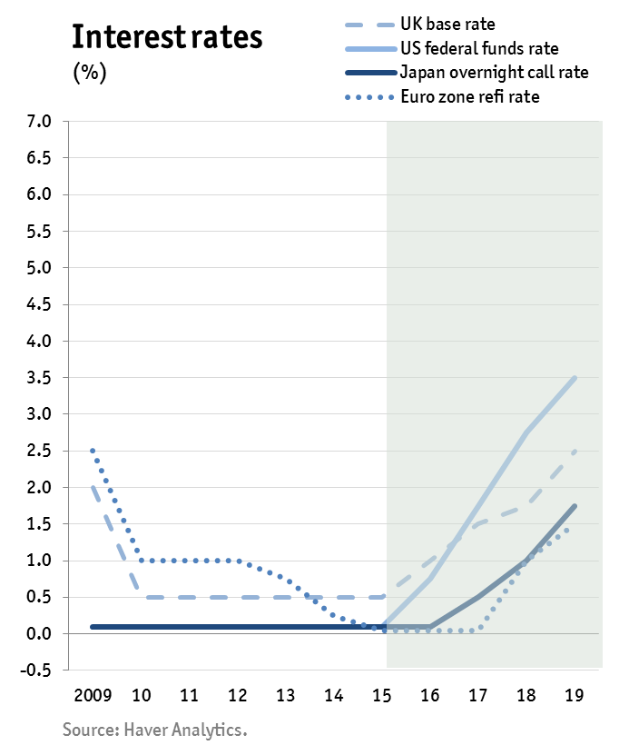
Monetary policy outlook
The US Fed ended its bond buying programme in October. Markets are looking ahead to the first hike in US policy rates, which we expect in the second half of 2015.
In response to deflationary pressures, the ECB again cut interest rates in September and announced measures to boost liquidity, including a programme of asset purchases. Germany opposes soverereign QE.
Bank of Japan has further expanded its monetary stimulus programme.
Monetary stances diverin EMs depending on country-specific factors.
US
Western
Europe
Japan
Emerging markets
Oil
Non-oil commodities
Monetary policy
Currency
Forecast risks
Forecast risks (cont.)
Summary
Notes:
Policy rates in the largest industrial economies are forecast to remain at ultra-loose levels at least until the end of 2010. Concerns not to inflate fresh bubbles will persuade the Federal Reserve (the US central bank) to start to tighten policy from 2011.

Slide 9
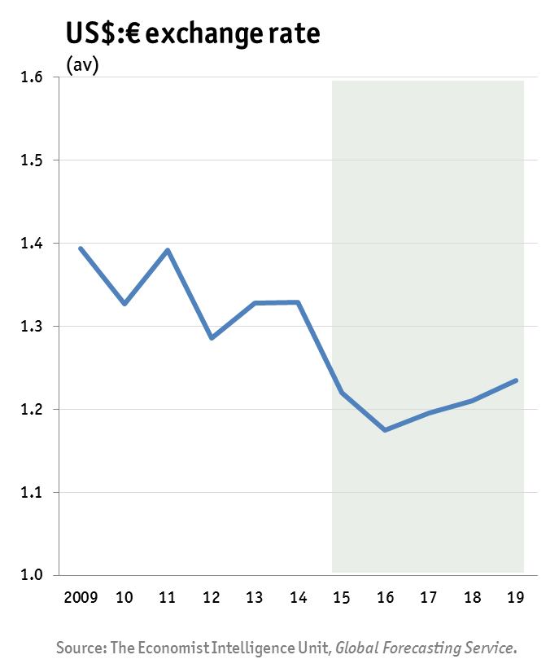
Currency outlook
Divergent outlooks for growth and monetary policy are pushing the dollar higher against the euro and the yen. The greenback is also strengthening against EM currencies.
We expect monetary tightening by the US Fed to continue to support a stronger US dollar for the next 18 months. In 2015 we expect the euro:dollar exchange rate to average US$1.22:€.
Over the medium term EM currencies should gain support by positive growth and interest rate differentials with OECD economies.
US
Western
Europe
Japan
Emerging markets
Oil
Non-oil commodities
Monetary policy
Currency
Forecast risks
Forecast risks (cont.)
Summary

Slide 10
Prediksi Nasional 2015 (KEN)
Pertumbuhan ekonomi 5.2% - 5.5% dengan asumsi stimulus fiskal dari hasil penghematan subsidi BBM akan efektif pada semester 2
Inflasi akan naik karena kenaikan harga BBM dan listrik (6.5-7.5%)
Suku bunga USA naik ➔ suku bunga acuan BI diperkirakan akan naik sampai 7.5- 8.5%
Nilai tukar terhadap USD akan sekitar Rp12.200 -12.700

Slide 11
Peluang 2015
Indonesia memiliki pertumbuhan ekonomi yang relatif tinggi
Populasi terbesar
Peningkatan kelas ekonomi menengah
Bonus demografi ➔ angka ketergantungan menurun karena usia produktif lebih banyak dari non produktif

Slide 12
KONDISI JAWA TENGAH SAAT INI dan 2015

Slide 13
Perkembangan output gap dan pertumbuhan ekonomi tahunan
Ekonomi Jateng pada 2013 cenderung mengalami pelambatan. Pada Tw. III mengalami perbaikan yang terbatas.
Struktur pengeluaran
Konsumsi rumah tangga masih dominan
Konsumsi pemerintah naik tajam di triwulan III-2014
Investasi mengalami perlambatan
Realisasi penanaman modal menurun
Perdagangan tidak lebih baik dari triwulan sebelumnya
Output gap masih relatif tinggi
Jateng termasuk provinsi dengan pertumbuhan ekonomi yang moderat

Slide 14
Pertumbuhan ekonomi
Penggunaan | 12.1 | 12.2 | 12.3 | 12.4 | 2012 | 13.1* | 13.2* | 13.3** | 13.4** | 13* | 14.** | 14.2** | 14.3**
C | 5.8 | 4.7 | 4.5 | 5.0 | 5.0 | 5.0 | 5.1 | 5.3 | 5.0 | 5.1 | 4.9 | 5.1 | 5.4
Kons Lembaga sasta nirlaba | 9.5 | 7.9 | 6.0 | 1.7 | 6.2 | 7.1 | 7.9 | 5.9 | 6.7 | 6.9 | 11.9 | 14.5 | 9.2
G | 15.2 | 6.6 | 0.1 | -0.4 | 4.7 | 2.2 | 3.8 | 7.6 | 8.1 | 5.6 | 4.8 | 0.8 | 5.3
I | 6.8 | 6.2 | 9.3 | 11.0 | 8.4 | 5.4 | 7.8 | 8.5 | 9.5 | 7.9 | 9.6 | 6.7 | 5.0
X | 18.5 | 2.3 | 10.2 | 8.3 | 9.5 | 3.7 | 8.9 | 10.5 | 11.2 | 8.6 | 10.2 | 7.3 | 7.2
M | 20.5 | 4.8 | 2.8 | 7.9 | 8.5 | 1.7 | 7.4 | 18.5 | 10.0 | 9.3 | 10.5 | 1.3 | 3.0
PDRB | 6.5 | 6.6 | 6.0 | 6.3 | 6.3 | 5.6 | 6.2 | 5.9 | 5.6 | 5.8 | 5.2 | 5.2 | 5.4
Keterangan: * angka sementara, ** angka sangat sementara
Sumber: BPS Jateng dalam KER Jateng TW III

Slide 15
Sektor | 12.1 | 12.2 | 12.3 | 12.4 | 13.1* | 13.2* | 13.3* | 13.4** | 14.1** | 14.2** | 14.3**
PERTANIAN | 1.5 | 1.8 | 3.9 | 9.3 | 0.9 | 2.4 | 3.5 | 2 | 1.6 | 0 | -2.3
PERTAMBANGAN DAN PENGGALIAN | 8.7 | 7.7 | 8.7 | 4.5 | 5.2 | 5.7 | 5.5 | 9 | 5 | 4.1 | 5.9
INDUSTRI PENGOLAHAN | 7.1 | 5.8 | 5.6 | 3.5 | 4.7 | 6.5 | 5 | 7.3 | 5.9 | 6.1 | 7.2
LISTRIK GAS DAN AIR BERSIH | 6.2 | 5.2 | 5.5 | 8.5 | 9.8 | 6.8 | 9.4 | 7.7 | 5.3 | 8.4 | 6
BANGUNAN | 7 | 7.6 | 7.9 | 5.4 | 6.1 | 6.9 | 6.9 | 7.9 | 7 | 5.5 | 4.3
PHR | 8.1 | 9.4 | 7.8 | 7.7 | 9.2 | 8.3 | 6.9 | 5.6 | 5.9 | 6.7 | 8.1
PENGANGKUTAN DAN KOMUNIKASI | 8.6 | 8.2 | 7.2 | 7.6 | 7.9 | 7.5 | 8.1 | 2.9 | 5.1 | 4.9 | 7.6
KEUANGAN, PERSEWAAN, JASA PERS | 7.8 | 9.7 | 10.4 | 9.5 | 9.9 | 9.7 | 11.3 | 11.3 | 11.2 | 9.4 | 7.4
JASA-JASA | 9.4 | 9.3 | 3.4 | 7.4 | 6.2 | 4.7 | 6.8 | 2.1 | 5.1 | 5.6 | 6.1
PDRB | 6.5 | 6.6 | 6 | 6.3 | 5.6 | 6.2 | 5.9 | 5.6 | 5.2 | 5.2 | 5.4
Keterangan: * angka sementara, ** angka sangat sementara
Sumber: BPS Jateng dalam KER Jateng TW III
Secara struktural tidak mengalami perubahan dalam 4 tahun terakhir
Pertumbuhan tertinggi juga terjadi pada 3 sektor dominan

Slide 16
Industri, Investasi
Kinerja sektor industri pengolahan meningkat dibanding triwulan sebelumnya 6.1% ➔ 7.2% (tw.3) ➔ dikuatkan dengan pertumbuhan impor bahan baku ➔ Menunjukkan bukti bahwa impor content masih kuat
Investasi mengalami pelambatan dari 6.7% menjadi 5.8% (tw3)
Terlihat dari pelambatan sektor bangunan dan turunnya volume impor barang modal (-57.51% -yoy; 5.25% mtm); turunnya kredit investasi, dan kegiatan investasi
Realisasi PMDN : 42, PMA : 66

Slide 17
Peta Inflasi
Inflasi Jateng lebih tinggi dibandingkan nasional, baik inflasi MTM maupun YOY
Disparitas inflasi di jateng besar
Inflasi Tw.3 menunjukkan penurunan, dan lebih rendah dari periode yang sama tahun sebelumnya
Inflasi yang relatif stabil tinggi adalah inflasi bahan makanan; makanan jadi, minuman , rokok dan tembakau; kemudian diikuti yang terkait dengan bahan bakar
Penurunan inflasi VF mencerminkan terjaganya pasokan bahan pangan, meski tetap merupakan penyumbang inflasi terbesar
Inflasi AP menurun ➔ belum terlihat dampak pengurangan subsidi BBM
Core inflation stabil dan cenderung melambat karena pelambatan inflasi inti nontraded dan ekspektasi inflasi

Slide 18
Inflasi
Sumber: KER Jateng TW III

Slide 19
Kemiskinan dan pengangguran
 | 2013 |  | 2014
Indikator | FEBRUARI | AGUSTUS | FEBRUARI | AGUSTUS
ANGKATAN KERJA | 17.46 | 17.52 | 17.72 | 17.55
BEKERJA | 16.50 | 16.47 | 16.75 | 16.55
PENGANGGURAN | 0.96 | 1.05 | 0.97 | 1.00
BUKAN ANGKATAN KERJA | 7.32 | 7.36 | 7.26 | 7.64
PENDUDUK USIA KERJA | 24.78 | 24.88 | 24.98 | 25.19
TPAK % | 70.46 | 70.42 | 70.93 | 69.68
TPT % | 5.50 | 5.99 | 5.45 | 5.68
Angka kemiskinan Maret 14 naik 2.81% dibanding sept 2013 ➔ 14.46% dari jumlah penduduk Jateng.
Terutama terjadi di perkotaan
Garis kemiskinan mengalami kenaikan

Slide 20
Outlook Jateng 2015
Pertumbuhan ekonomi 2014 diperkirakan sedikit lebih tinggi dibanding 2013 [5.2-5.3%], sedangkan di 2015 triwulan 1 diperkirakan pertumbuhan melambat menjadi 5.1% karena efek inflasi administered price.
Sektor dominan diperkirakan tidak mengalami perubahan. Industri manufaktur diperkirakan mengalami pelambatan
Konsumsi RT masih menjadi faktor pendorong pertumbuhan ekonomi, Pengeluaran pemerintah akan mengalami kenaikan, ekspor juga diperkirakan akan mengalami kenaikan.

Slide 21
Strategi dalam menata iklim investasi yang pro investor
Daya Tarik
Pengembangan mind set birokrat
Pelaporan/update rutin dan berkala
Komunikasi peluang investasi dan potensi keuntungan
Metode pemasaran melalui media dan persuasi
BKPMD menerapkan sistem birokrasi yang efisien
Daya Tahan
Strategi purna jual, mengawal perkembangan investor
Menjaga stabilitas wilayah termasuk hubungan perburuhan
Meminimumkan biaya ekonomi
Memfasilitasi dan mengembangnkan sistem persaingan yang sehat
Daya Saing
Meningkatkan kualitas tenaga kerja
Meningkatkan kualitas dan ketersediaan infrastruktur
Membuka akses pasar

Slide 22
Dikotomi kemiskinan desa kota ➔ masih relevankah mengingat arus urbanisasi yang begitu besar
Pemicu utama inflasi adalah pangan dan BBM
Desa berdikari bukan desa as a village tapi lebih ke interconection antar wilayah perdesaan
Fokus ke ketahanan pangan dan energi dengan perspektif kemiskinan dan pengangguran

Slide 23
Fokus pembangunan Jateng
Infrastruktur
Ketahanan pangan dan energi
Perspektif pengurangan kemiskinan
dan pengangguran

